Slide 1
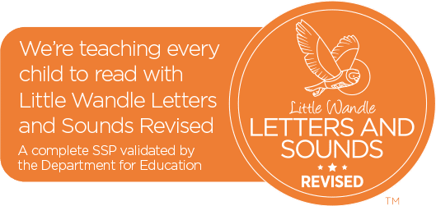
Welcome to the
Phonics Screening Check Meeting for Parents
24th April 2023

Slide 2
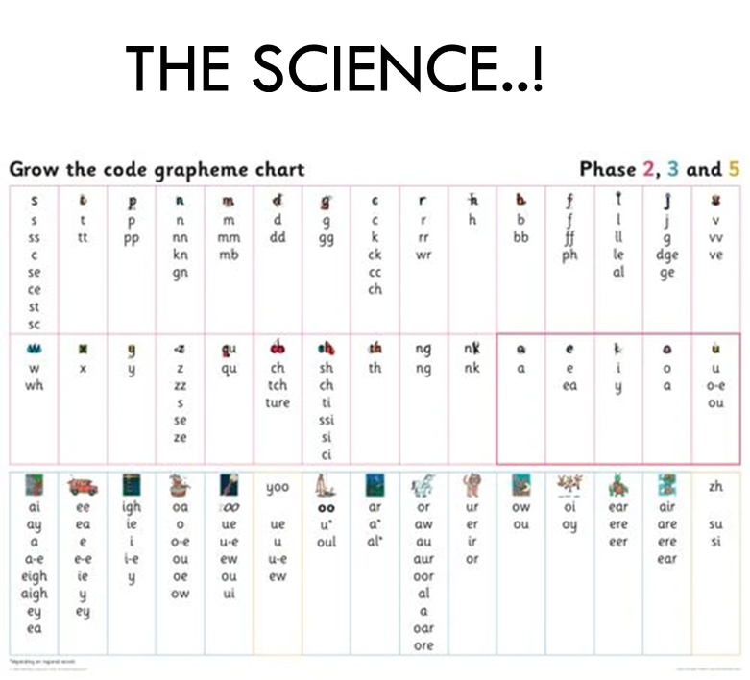

Slide 3
The Alphabetic Code
▶ English is an alphabetic language
▶ There are 26 letters in the English language
▶ There are approximately 44 sounds (phonemes) in the English language
▶ Combined they make in excess of 140 letter combinations (graphemes)

Slide 4
Terminology
▶ Phoneme – the smallest unit of sound in a word.
▶ Grapheme – a letter or group of letters that
represent a phoneme.
▶ Blending – merging the individual phonemes together to read a word all the way through. Children should sound out each phoneme, not letter when reading unfamiliar words.
▶ Segmenting – hearing and saying the individual phonemes within words. In order to spell, children need to segment a word into its component phonemes and choose a grapheme to represent each phoneme.

Slide 5
▶ Digraphs – two letters representing one phoneme
▶ Consonant digraphs: ll ss ff zz ng
▶ Vowel digraphs: ai ee ew oa ar
▶ Split Vowel digraphs: a-e e-e i-e o-e u-e
▶ Trigraphs: three letters making one phoneme
ear air ure
tch
dge
igh

Slide 6
The National Phonics Screening Check was introduced in 2012.
This Academic year schools across England will administer the Year One
Phonics Screening Check the week beginning Monday 12th June 2023.
This check is statutory for all maintained schools.
All pupils in our current Year One and some Year 2 pupils at Hangleton Primary School will take the Screening Check.

Slide 7
The Phonics Screening Check is designed to show how well your child can use the phonics
skills they have learned up to the end of Year One, and to identify pupils who need extra phonics help.
The screening check assesses whether your child is able to read/decode at an appropriate standard.
The Department for Education defines the checks as “short, light-touch assessments” that take about four to nine minutes to complete.

Slide 8
What does the
Phonics Screening Check consist of?
The check consists of 40 words that your child will be asked to read one-on-one with Mr Dargavel or Ms Keene.
There will be 20 ‘real’ words and 20 ‘pseudo-words’ (non-words).

Slide 9
Non-words (nonsense words, pseudo words, Alien words) are a collection of letters that will follow phonics rules your child has been taught, but don’t mean anything.
Each of the non-words is presented with a picture of a monster/alien.
Your child will need to apply their knowledge of phonemes to read these correctly, showing that they understand the phonics rules behind them.

Slide 10


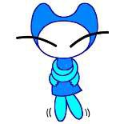
tox
jound
fape

Slide 11
ulf
thazz
quemp

Slide 12
The 40 words and non-words are divided into two sections –
simple word structures of three or four letters
more complex word structures of five or six letters.
The teacher with the children will give your child a few practise words to read first.

Slide 13
shin
newt
best

Slide 14
slide
phone
midnight

Slide 15
Marking the Phonics Screening Check.
The check will be marked by Mr Dargavel or Ms Keene.
The check will be administered in accordance with the Standards and Testing Agency’s check administration guidance.
Schools are monitored by unannounced monitoring visitors from local authorities in order to ensure that administration of the checks are accurate.

Slide 16
All schools will report their phonics
screening check data to their Local Authority
The threshold mark is communicated to schools by the start of July, after the test has been taken and
all schools have submitted their pupils’ scores.
Your child will be scored against a national standard, and their result will indicate whether or not they fall below or within this standard.

Slide 17
Threshold Mark.
In previous years, the "pass threshold" was 32 , which meant that children had to read at
least 32 words out of 40 correctly (80%).

Slide 18
How can I help my child prepare?
Revise the phonics that the children have already learnt
Read new books and stories with your child
Stay calm, be positive, the children do this daily!

Slide 19

Any questions?

